Slide 1
Reaction Mechanisms & ROMs

Slide 2
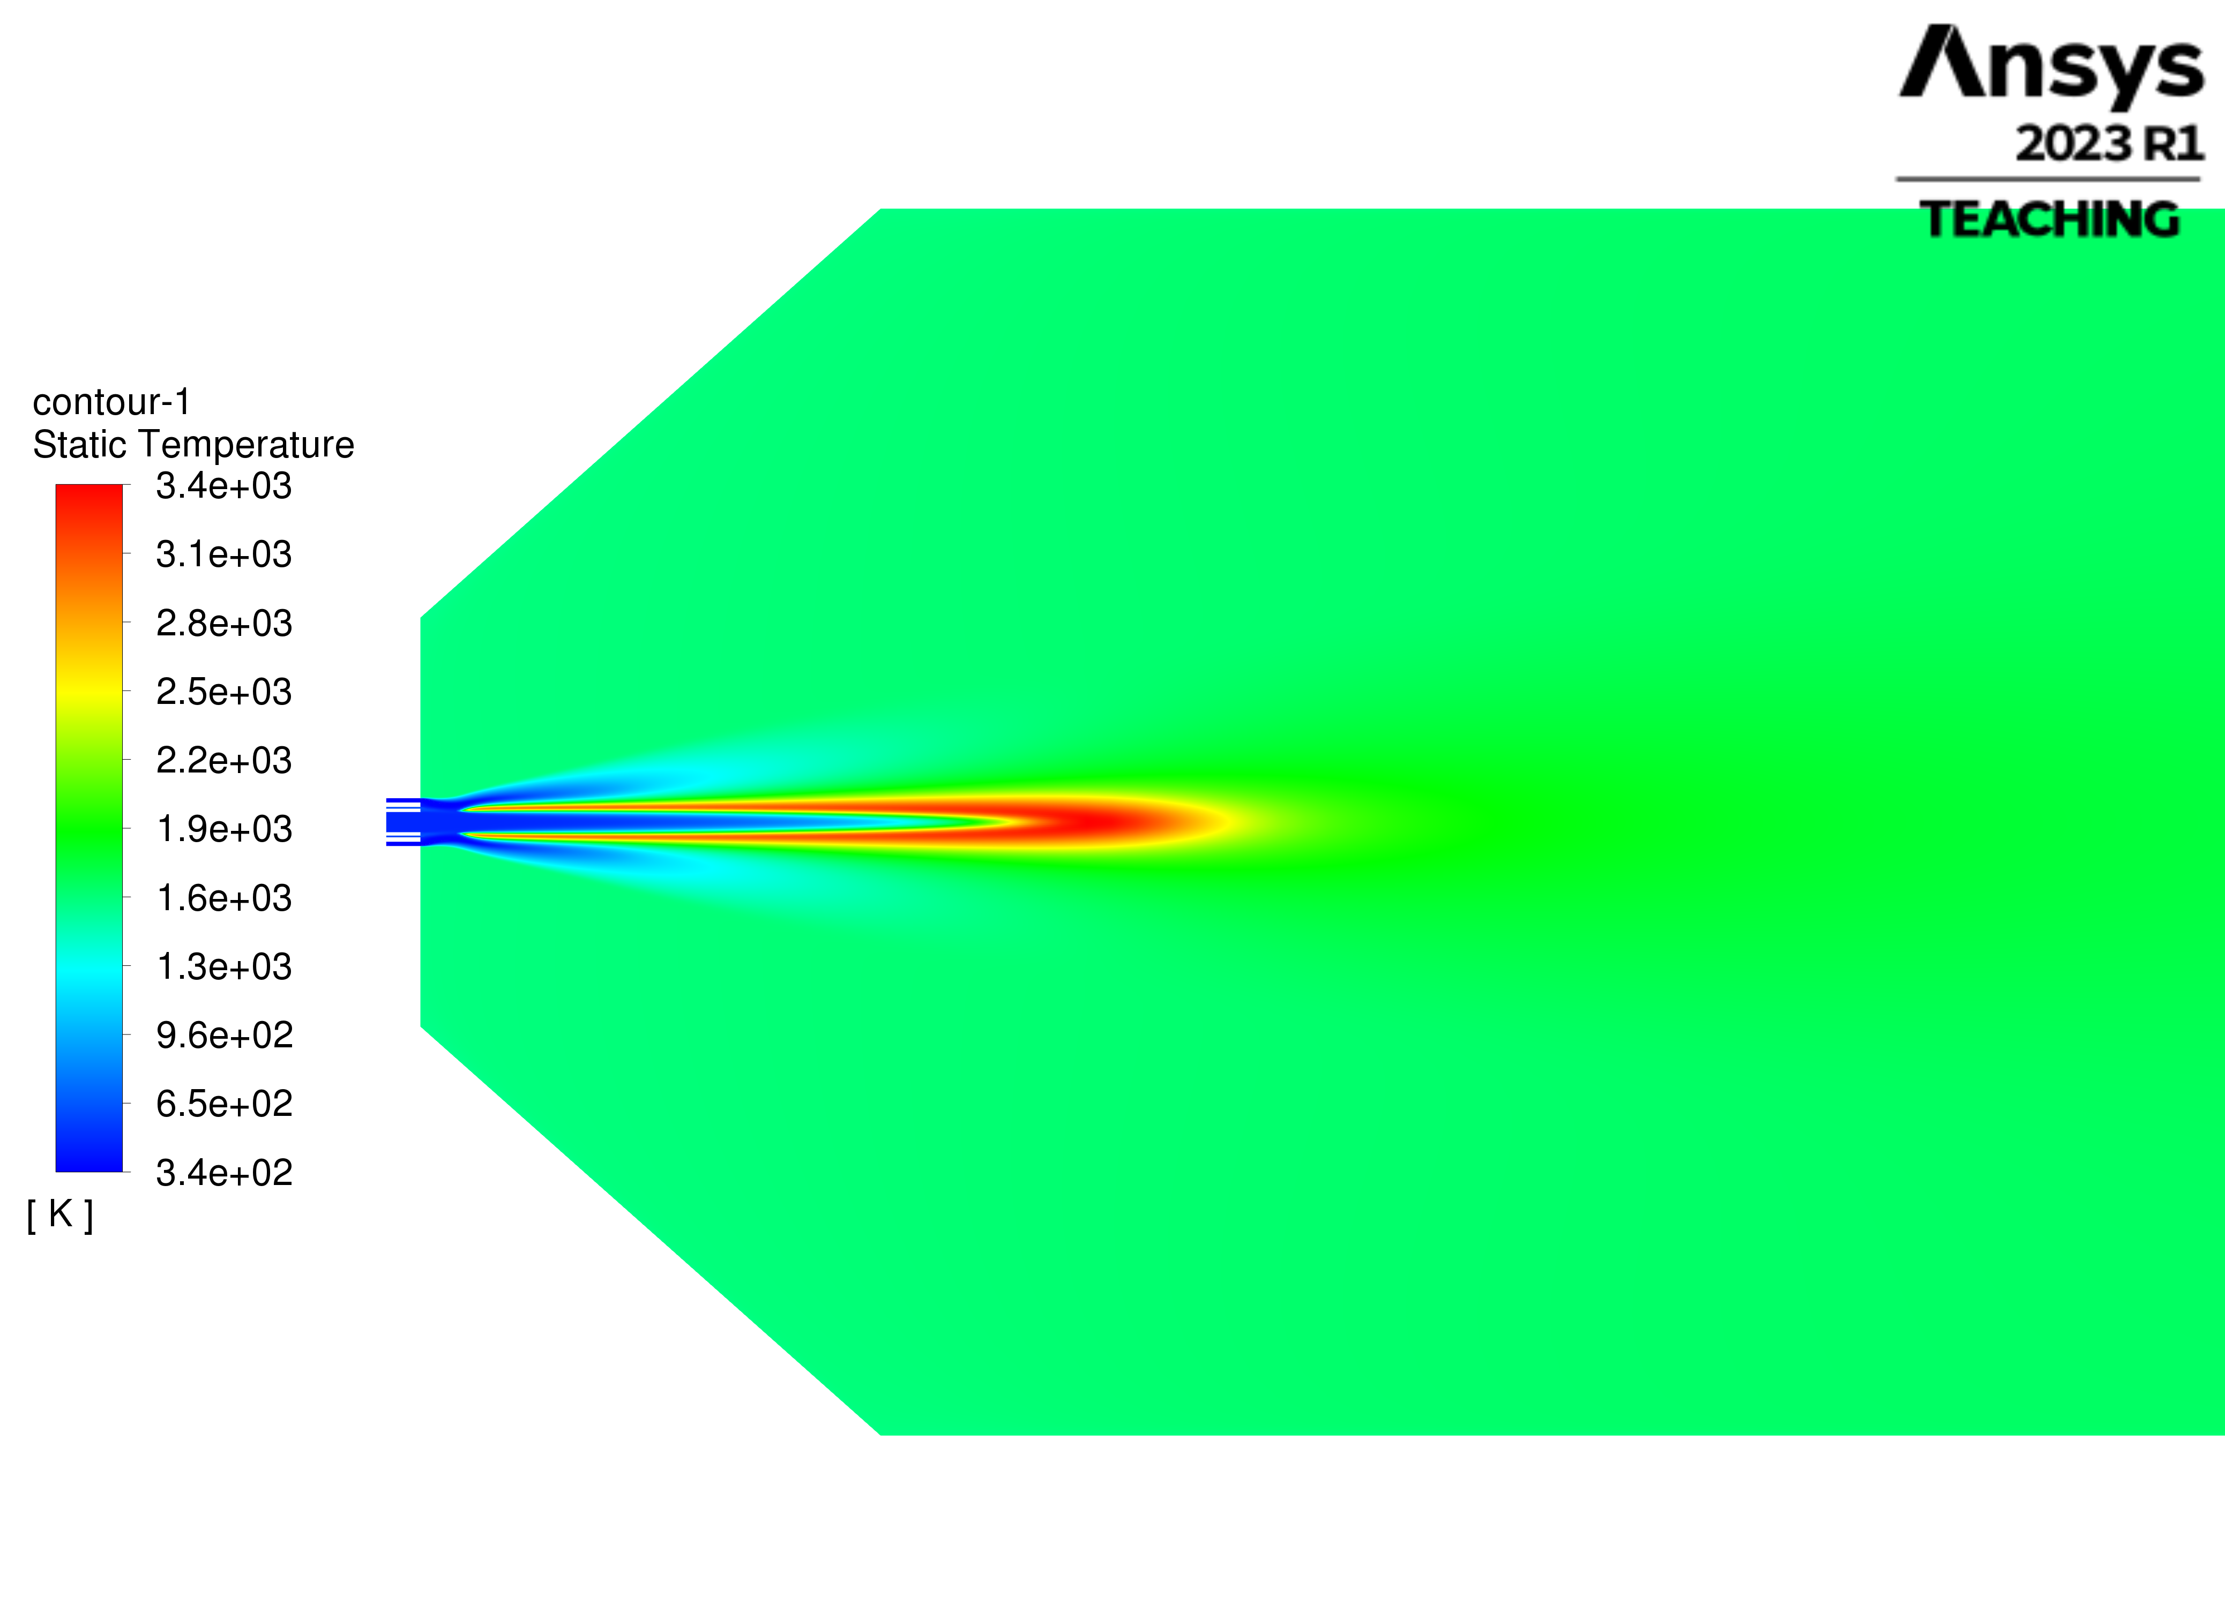
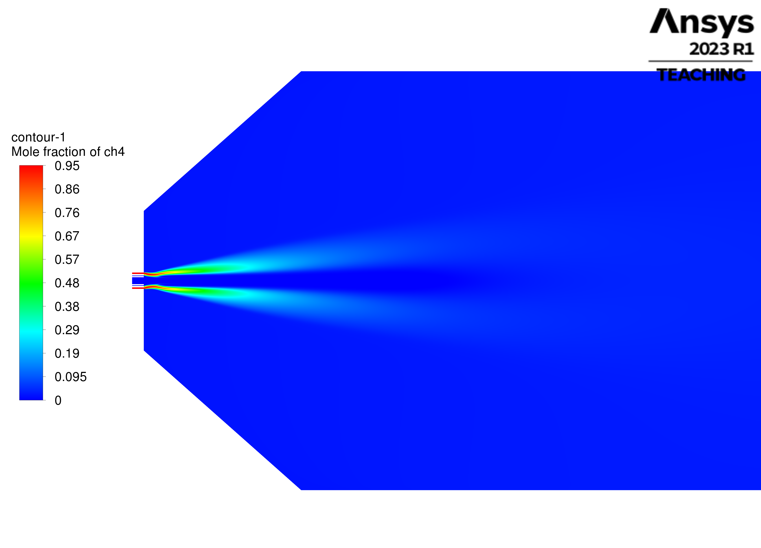
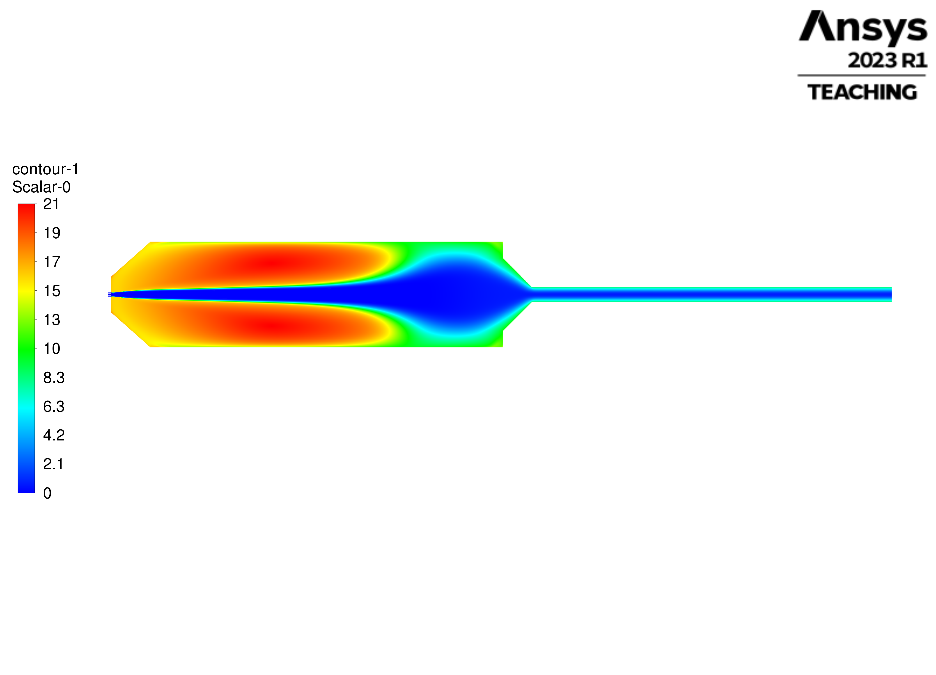



Reactor Network Modeling – Based on CFD Results
Temperature Profile: Flame zone
Methane Profile: Methane bypass zone
Residence Time: Recirculation – Channeling zones
PSR4
PSR1
PSR2
PSR3
PFR1
PFR2
PFR3

Slide 3
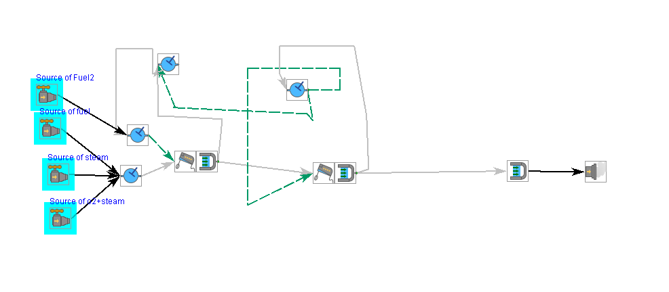
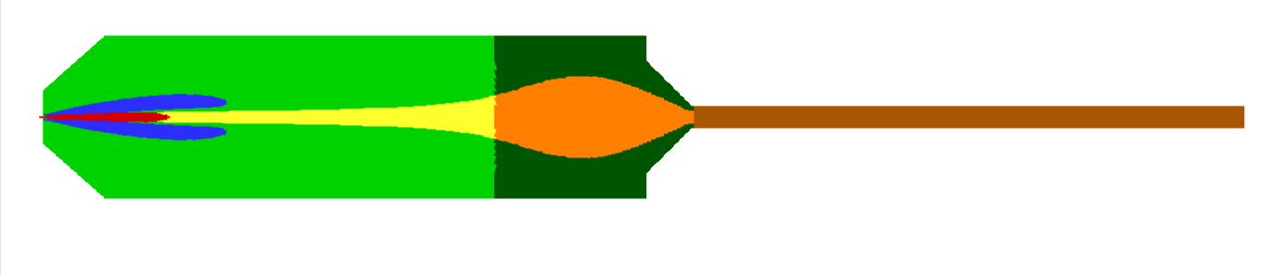
Reactor Network Model
Reactor Segmentation
ROM Model
PSR3
PSR2
PSR4
PSR1
PSR2
PSR4
PSR3
PFR1
PFR2
PFR3
PSR1
PFR1
PFR2
PFR3

Slide 4
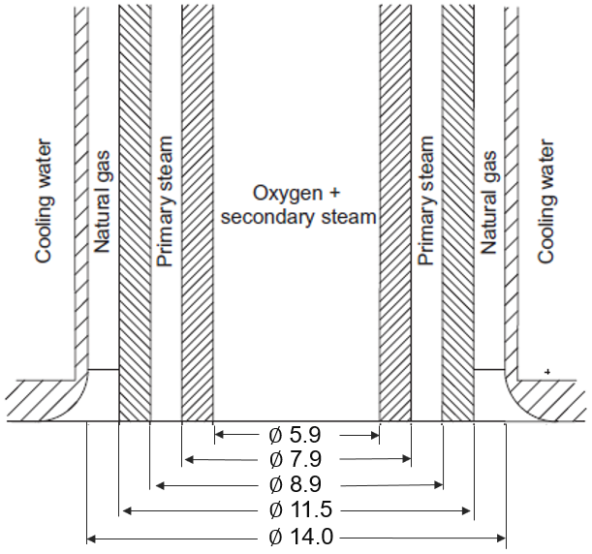
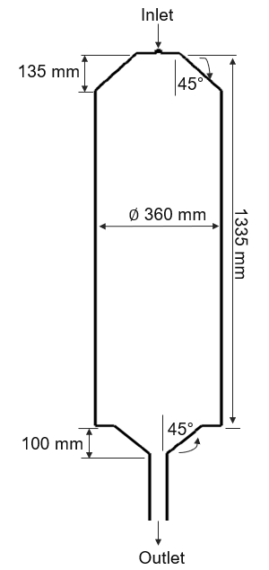
Cases GasPOx215
Variables |  | Case 1 | Case 2
1. Natural Gas
Temperature | °C | 66.6 | 67.5
Mass Flow | kg/h | 182.4 | 153.3
2. Carbon Dioxide
Temperature | °C | - | 67.5
Mass Flow | kg/h | 0 | 196.4
3. Oxygen
Temperature | °C | 231.9 | 231.2
Mass Flow | kg/h | 252.2 | 246.9
4. Steam
Temperature | °C | 353.4 | 353.4
Mass Flow | kg/h | 38.7 | 39.4
Wall Heat Loss | kW | 30 | 30
Reactor Volume | L | 134 | 134
Comment |  | Reference | CO₂ import

Slide 5
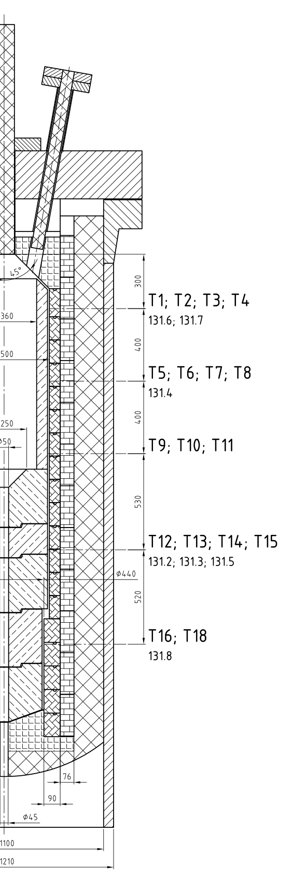
Results GasPOx215
 |  | EP 11 | EP 9
 | Units | EXP | EXP
Syngas (wet) | kg/s | 0.133 | 0.178
Temperature Outlet | °C | (1300) * | (1342) *
Temperature T102.11 | °C | 1407.4 | 1411.4
Temperature T102.15 | °C | 1351.9 | 1371.6
H₂ | Vol.- dry | 0.599 | 0.416
CO | Vol.- dry | 0.341 | 0.424
CH₄ | Vol.- dry | 0.007 | 0.0012
CO₂ | Vol.- dry | 0.048 | 0.151
H₂/CO | - | 1.759 | 0.981
*Aspen calculated temperature

Slide 6
Ergebnisse Case 1
 | Experiment | Simulation 1 | Simulation 2 | Simulation 3 | Simulation 4 | Simulation 6
H₂ | 0,599 | 0,6173 | 0,6175 | 0,5918 | 0,6090 | 0,5842
CO | 0,341 | 0,3420 | 0,3418 | 0,3364 | 0,3331 | 0,3417
CH | 0,007 | 0,00125 | 0,00118 | 0,0207 | 0,0103 | 0,0295
CO₂ | 0,048 | 0,0395 | 0,0396 | 0,0511 | 0,0476 | 0,0447
Temperatur 0 | 1573,2 | 1582,9 | 1584,6 | 1550,8 | 1447,7 | 1708,0
Temperatur 15 | 1625,1 | 1610,4 | 1614,0 | 1598,4 | 1530,0 | 1708,2
Temperatur 11 | 1680,6 | 1793,2 | 1900,0 | 1717,8 | 1704,4 | 1706,9
Ähnlichkeit (0 = perfekt) | 0 | 68,54 | 120,99 | 43,156 | 122,18 | 122,18

Slide 7
Ergebnisse Case 2
 | Experiment | Simulation 1 | Simulation 2 | Simulation 3 | Simulation 4 | Simulation 6
H₂ | 0,416 | 0,4360 | 0,4360 | 0,4252 | 0,4304 | 0,3916
CO | 0,424 | 0,4366 | 0,4365 | 0,4337 | 0,4375 | 0,4369
CH₄ | 0,0012 | 0,000081 | 0,000081 | 0,00738 | 0,00226 | 0,0213
CO₂ | 0,151 | 0,1274 | 0,1274 | 0,1337 | 0,1298 | 0,1502
Temperatur 0 | 1615,2 | 1246,8 | 1644,9 | 1643,0 | 1656,8 | 1725,2
Temperatur 15 | 1644,8 | 1272,6 | 1669,5 | 1662,2 | 1679,7 | 1726,9
Temperatur 11 | 1684,6 | 1334,7 | 1904,6 | 1708,0 | 1730,7 | 1723,8
Ähnlichkeit (0 = perfekt) | 0 | 545,19 | 137,32 | 34,38 | 61,36 | 115,72

